Slide 1
Introduction to Scalability
By David Welker

Slide 2
Your website is growing steadily
This is great for business, but what problems might this cause?

Slide 3
Shared Hosting
$2.59 to $10.95 per month.
Unlimited Traffic.
Unlimited Traffic!
Unlimited Traffic!!
The fine print. “We don’t track bandwidth or traffic, so you never have to worry about pesky overage fees.”

Slide 4
What if you need more than “unlimited”?

Slide 5
Owning your own server
What are the advantages?
What are the disadvantages?
How do you scale?

Slide 6
Vertical Scaling
Get a better machine.
More RAM.
More CPUs.
More Cores.
Bigger Disk.
Better Disk. (HDD versus SSD)
Etc.
Extreme example: A supercomputer.

Slide 7
Thought Experiment: Buy a Supercomputer?
What limitations does this approach have?
What advantages does this approach have?

Slide 8
Any software issues due to vertical scaling?

Slide 9
How do you recover from failures?
Disk Failure
Power Failure
Fire

Slide 10
What is the alternative to vertical scaling?

Slide 11
Horizontal Scaling
Instead of a bigger computer, add more computers.

Slide 12
Networking: Basic Vocabulary
What is an IP address?
What is DNS?
What is a Public IP versus a Private IP?
What is IPv4? What is IPv6?

Slide 13
Websites: Basic Vocabulary
What is a URL?
What is HTTP?
What is HTML?
What is CSS?
What is JavaScript?
What is server-side scripting?
What is a cookie?
What is a session?

Slide 14
Simplified Systems Interview
Problem: If you have multiple machines, design a system to route requests to them.
Criticism 1: What if, through random chance, one of your systems becomes overloaded?
Criticism 2: How can you minimize security problems?
Criticism 3: Doesn’t your solution break user sessions?

Slide 15
Why is horizontal scaling hard?
What networking problems does this create?
What caching problems does this create?
What database problems does this create?

Slide 16
Caching
Advantages?
Disadvantages?

Slide 17
Student Systems Design Mini-Interview
How would you design a cache?

Slide 18
Problem: What About Failure?
Solution 1: Buy really expensive hardware that is very reliable.
Solution 2: Use replication to leverage less expensive hardware.
Solution 3: Hybrid approach.
Principle: Avoid single points of failure.

Slide 19
Student Systems Design Mini-Interview
Problem Context:
A database often has its own server. Why?
Assume that a database has its own server. But, if that server goes down, our website can go down. And we can lose millions of dollars.
Problem:
Design a system that addresses the issue of this single point of failure.

Slide 20
Replication
Single-points of failure may be eliminated by replication.
Often, a master-slave configuration is used. Often the master will handle writes, while slaves may be handle reads.
What problem does this design introduce?

Slide 21
Databases
What is a database, anyway?
Based on the above definition, is a filesystem a database?
What is a relational database?
What is a NoSQL database?
What is sharding?
Why have NoSQL databases become popular?

Slide 22
Partitioning
Use a high-level characteristic to decide which server to use.
Early days of Facebook, they portioned based on school. Harvard versus MIT.

Slide 23
High Availability
The ability to recover quickly (ideally automatically) from a failure.

Slide 24
Big Data: MapReduce
Problem: How can we divide a large computation among many machines?
Algorithm developed by Google to rebuild its index of the web, basis for Hadoop and Spark. Google moved on from MapReduce to index the web due to the problem of stragglers and unsuitability for real-time processing.
Programmers focus on two steps. Map (basic work on many machines, done in parallel) and Reduce (combining answers, also done in parallel).

Slide 25
The Cloud
Why own, when you can rent?
Use only what you need. Get better security, replication, stability, etc. than you would likely be able to produce on your own.
Automatically allocate resources when needed. Release those resources at other times. (If you own it yourself, you must buy enough for peak loads, but then experience idleness at other times.)
What are the downsides?

Slide 26
Virtual Machines
Also known as hypervisors.
What is a virtual machine?
How does a virtual machine work?
Why are virtual machines so useful in a cloud environment?
Types: Bare Metal versus Hosted.
Example Technologies: VMWare Fusion, Oracle VirtualBox

Slide 27
Microservices
What is a microservice?
What is a monolithic application?
What are some of the benefits of microservices?
What are some of the costs of microservices?

Slide 28
Containerization
Defined as separation of applications from the environment in which they actually run.
Similar to virtual machines, but virtualize at the OS-level instead of the hardware level.
What are the benefits of this approach?
What are the costs to this approach?
Example Technology: Docker

Slide 29
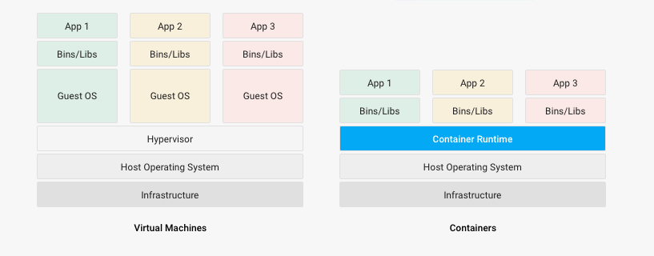
Virtual Machines versus Containers

Slide 30
Container Orchestration
Health checks for high availability.
Automatic rollout, and rollbacks.
Automatic scaling, allocate and deallocate resources based on demand.
Deploy to multiple clouds.
Example Technology: Kubernetes

